Slide 1
DSSC 2017
Pharmanalytics :- Mariam Elgabry
Christos Oikonomou
Lisa Schneider
Bharathy Ganeshanathan

Slide 2
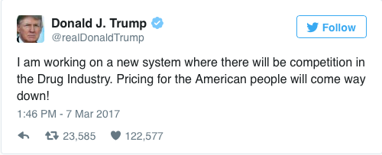
Initial Idea
Investigate political influences on stock price variations on Pharmaceuticals based in the UK

Slide 3
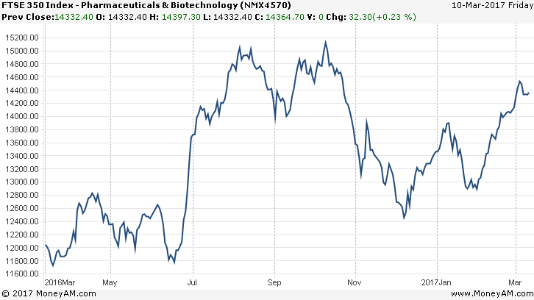
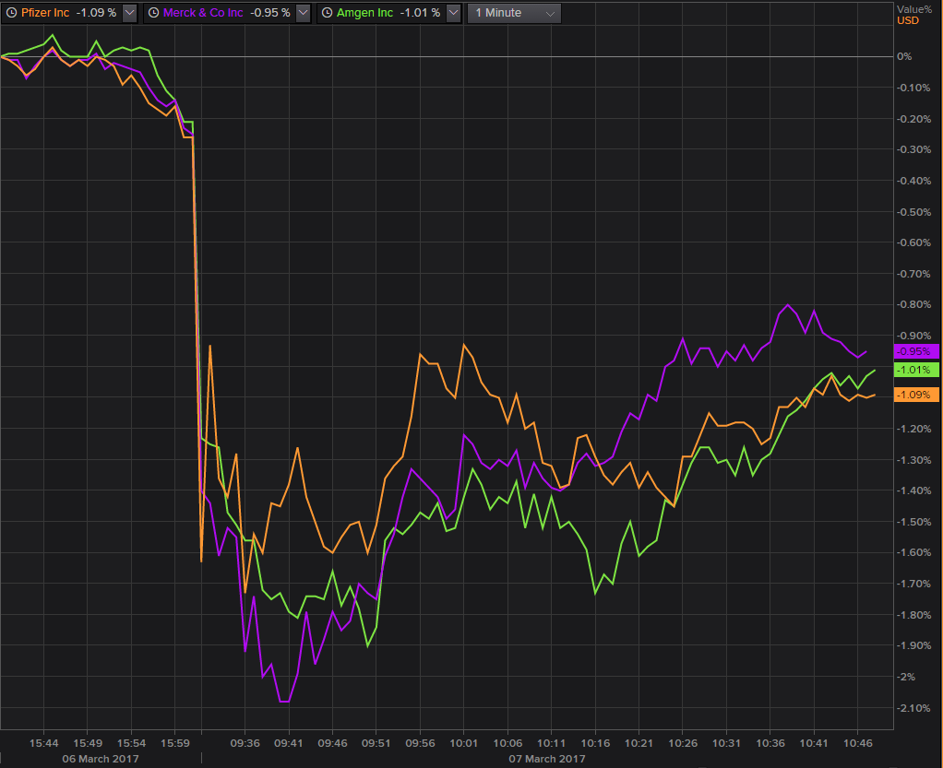
Effect of Trump’s tweet
Effect of Brexit

Slide 5
Creating a Model
Linear Regression Model
Addition of differences in quarterly GDP values
Minimal effect to 2 d.p
The dilemma
Difficulty in acquiring pharmaceutical data in short span of time
Dealing with the difficulty
Training the model alternatively to use previous data points

Slide 6
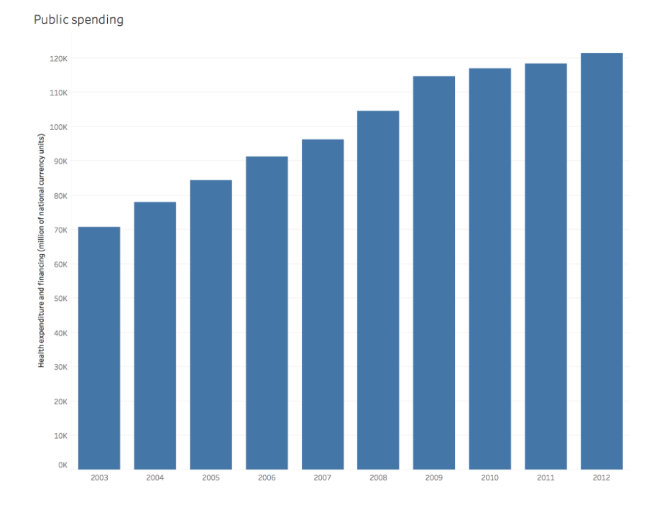

Slide 7
